Slide 1


High Performance Cluster Computing
Architectures and Systems
Hai Jin
Internet and Cluster Computing Center

Slide 2
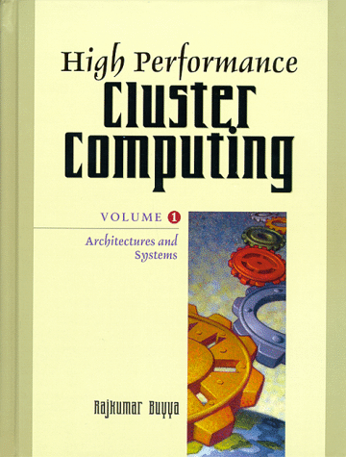
Load Balancing Over Network
  Introduction
  Methods
  Common Errors
  Practical Implementations
  Summary

Slide 3
Introduction (I)
Load balancing over a network
  Use of devices external to the processing nodes in a cluster
  Distribute workload or network traffic load across the cluster
  Nodes may be interconnected among themselves
    must be connected directly or indirectly to the balancing device
Processing nodes
  Provide various status information
    current processor load
    the application system load
    number of active users
    the availability of network protocol buffers
    other specific resources

Slide 4
Introduction (II)
Balancing device
  monitors the status of all the processing nodes
  dictates where to direct the next processing job
  can be a single unit or a group of units working in parallel or under a tree hierarchy
  use one or more algorithms or methods together with static or dynamic setting to decide which node gets the next incoming connection request

Slide 5
Introduction (III)
Two ways of network load balancing
  Network point of view
    Load balancing system monitors incoming data to a cluster and distributes traffic based upon network protocol and traffic information
  An application point of view
    Higher level in the network communications model
    It is possible to build an application-specific balancing system on top of an existing network-specific balancing system or combine the two into a more complex system

Slide 6
Methods (I)
Implement of load balancing
  Through the employment of several basic methods
    Can be combined to create more advanced system
Methods
  Can be looked upon as mathematical functions that work on statistics of network traffic and node status to determine an appropriate target for receiving new load
  Each of these functions are influenced by several factors
    define behavior and role of the device

Slide 7
Methods (II)
How new traffic is to be distributed across the nodes of the cluster
  Factors Affecting Balancing Methods
  Simple Balancing Methods
  Advanced Balancing Methods

Slide 8
Factors Affecting Balancing Methods (I)
Define the capabilities and limits of the balancing device
Influences of the environment that the device works in and have to support
  The most basic factor: TCP/IP
    lack of a separate session layer
    lack of appropriate QoS guarantee system
    IP, ICMP, TCP, UDP

Slide 9
Factors Affecting Balancing Methods (II)
Network Address Translation (NAT)
  Converting internal or private network address and routing information into external or public addresses and routes
  Due to the limited address space of the current version of the IPv4
  For security reason, NAT as firewall
  Any balancing device required to perform network address translation must keep separate tables for internal and external representations of computer or host information
  Cannot be used with VPN (Virtual Private Networks)

Slide 10
Factors Affecting Balancing Methods (III)
Domain Names
  Form the basis of many balancing methods
  Mapping Fully Qualified Domain Name (FQDN) to IP address
    combination of both the host name and the domain name to create a uniquely identifiable name for a system on the Internet
  Domain Name System (DNS)
    The standard translation mechanism
    Mapping names to address and vice versa
    Map multiple hosts to a single host name
  As most computer are referenced by their FQDN and not their direct IP address
    DNS server becomes a crucial aid to the balancing device system to help determine load distribution

Slide 11
Factors Affecting Balancing Methods (IV)
Wire-speed Processing
  Ability to perform network traffic processing and redirection at the full speed of the incoming packets to prevent any traffic bottlenecks at the network device
  Operating system may be limited in this capacity
  This can result in slower response or an inability to accept new connections at individual nodes in a cluster

Slide 12
Factors Affecting Balancing Methods (V)
Node Operating System Limitation
  Some operating systems have limitations
    the speed at which they can process packets
    the number of connections they can support
    the type of traffic they can accept
  Large number of interrupts as new packets arrive
  This affects the cluster in much the same way as for wire-speed processing

Slide 13
Factors Affecting Balancing Methods (VI)
Balancing Device Limitation
  All balancing devices have practical limitations incurred by memory and processing speed
  Balancing methods which work well in small clusters may not be scalable to large numbers of nodes
    Keep tables of information on incoming connections and node status
    Table limit the size of the cluster and the traffic processing rate

Slide 14
Factors Affecting Balancing Methods (VII)
Session- and nonsession-based Traffic
  Session-based traffic
    Look for IP packet with TCP_SYN and TCP_FIN messages as the start and end of a session
    Direct all traffic between the source and destination to a specific node in the cluster
  Nonsession-based traffic
    Cannot be completely accounted for
    Created a patchwork system for UDP
      Keeping track of incoming datagram from a source
      Establishing a time limit for a ‘session’
      Time interval-based ‘UDP session’ management

Slide 15
Factors Affecting Balancing Methods (VIII)
Application Dependencies
  Some applications require that once a source computer has accessed a particular node, they continue to connect to that same node every time in the future
    continuous service in shared nothing cluster
  Can be fixed by changing the application code to build a more cluster-aware application
    this is not always possible

Slide 16
Simple Balancing Methods (I)
A single function that select the node within a cluster to send a new request to
Some of these methods can be used by themselves
Used in conjunction with another simple or advanced method

Slide 17
Simple Balancing Methods (II)
Weighting
  Provides a simple way of conferring load onto the nodes according to the priority value or weight of the node
  Different weights to the nodes of different capacities
Randomization
  Assigns each node with a value generated by a pseudorandom algorithm
  Works good in identical node environment

Slide 18
Simple Balancing Methods (III)
Round-Robin
  Assigns the next incoming request to the next node in the list and rotates through the list continuously for further requests
  Commonly used by itself in DNS
  DNS servers don’t keep track of server load
    IP caching problem
  Effective where all the nodes in the cluster are identical in capacity and performance
  Limitations
    no knowledge of nodes, address caching

Slide 19
Simple Balancing Methods (IV)
Hashing
  Works similar to the simple weighting system
  Benefit
    Packets from the same source address will always get assigned to the same server
Least Connections
  Keeps track of all currently active connections assigned to each node in the cluster
  Assigns the next new incoming connection request to the node which currently has the least connections
  Differ from actual amount of processing
  Problem
    Consume more system resource than others
  Solution
    Sets a maximum limit on the number of connections assigned to each node

Slide 20
Simple Balancing Methods (V)
Minimum Misses
  Keeps long-term track of all incoming requests assignments to the nodes
  Assign the next incoming request to the nodes which has processed the least number of incoming request in its history
  Difference with Least Connections
    this keeps track of the number of current and past connections

Slide 21
Simple Balancing Methods (VI)
Fastest Response
  Keeps track of the network response time between the node and itself
  Assigns the next incoming connection request to the node with the fastest response
  Requires active monitoring of the individual nodes
    Sending ICMP packets with the ‘ping’ command
    Proprietary mechanism based upon UDP packets
  Make little sense except heavy load down
  Useful in different network segments

Slide 22
Advanced Balancing Method (I)
Primary optimization vectors
  Network traffic optimization
  Fair load distribution
  Network route optimization
  Response latency minimization
  Application-specific performance
  Administrative or network management optimization

Slide 23
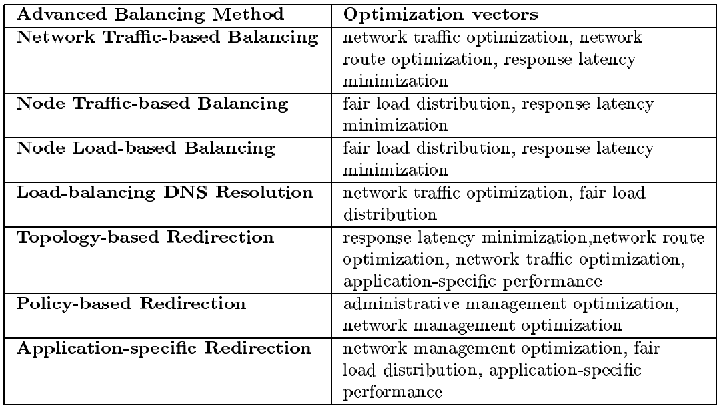
Primary Optimization Vectors of Advanced Balancing Methods

Slide 24
Advanced Balancing Methods (II)
Use a combination of the simple systems described earlier
Network Traffic-based Balancing
  Requires active monitoring of incoming traffic from different sources and distributing them accordingly to the nodes
  Focus on predicting the volume of incoming traffic from a source on the network based upon past history
  Based on a simple weighting function

Slide 25
Advanced Balancing Methods (III)
Node Traffic-based Balancing
  Converse of the network traffic balancing system
  Used Least Connections
  Contact software agent on the node
  Monitoring of the status of the network buffers
Node Load-based balancing
  Software agent
  CPU or system load in UNIX systems
  Various system load in Windows NT systems

Slide 26
Advanced Balancing Methods (IV)
Load-balancing Domain Name Resolution
  Involves the Round-Robin method
  Load-balancing occurs within the DNS server itself
  Independent of the application that generates the traffic
  Can create an effective load-balancing system
    by adding a few algorithms to a standard DNS server application
  Simple & most popular
  Best used in a cluster of nodes with identical applications

Slide 27
Advanced Balancing Methods (V)
Topology-based Redirection
  Redirect traffic to the cluster nearest to the user’s computer in terms of network topology
    Hop count (static) and network latency (dynamic)
  Hop count is the number of routers the packets have to traverse to reach the destination
  Network latency is the amount of time taken for a network packet to travel between the client and the cluster balancing device
    fastest response
    a top level node in a particular domain
  Effective in several clusters deployed across a network

Slide 28
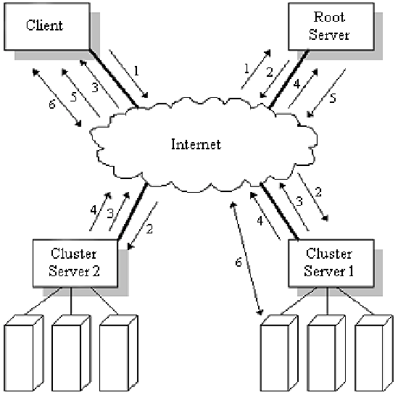
Ping Triangulation in Topology-based Redirection

Slide 29
Advanced Balancing Methods (VI)
Policy-based Redirection
  Application of a mathematical or functional set of rules that define the balancing behavior of the cluster
  Bandwidth Allocation Policies
    higher priority on network administration & security control
  Administrative Policies
    specific to the needs of each message in network environment
  Security Policies
    proper access right for access the resource

Slide 30
Advanced Balancing Methods (VII)
Application-specific Redirection
  Provides load-balancing features dependent upon the type application or resource the client trying to access
  Support for application level of sessions
  Database & Web load-balancing

Slide 31
Common Errors (I)
There are four common errors
  Overflow
  Underflow
  Routing errors
  Induced network errors
That can be destabilize efficient network clustering

Slide 32
Common Errors (II)
Overflow
  Occur when too much network traffic to process
  Occur at the balancing device or at individual nodes
  Result
    lost packets or throttling of packets intended for a destination node
    loss of data and processing
  The balancing device
    Usually much greater than that of individual cluster node
    But it possible to be overflow
    Result in throttling or deleting some data streams to the nodes (leaving an adequate level of traffic to the node)
  In TCP connections
    There is an idle timeout clock for receiving an acknowledge
    In an overflow situation, the acknowledge can’t be send back
    Retries from the client to deliver the same packet again until the timeout limits or connection dropped

Slide 33
Common Errors (III)
Underflow
  A problem within the cluster itself
    where one node is not getting enough traffic as compared to the other member nodes
  Result
    The node is underutilized or starved while others are getting loaded down
    Indicating an inefficient distribution of traffic
  This is typically a problem
    with the algorithm itself or
    with the improper use of the system
  Problem of Non symmetric nodes
    where nodes in the cluster are not identical in power and one or more member nodes have far more computing resources than other

Slide 34
Common Errors (IV)
Routing Errors
  It occurs
    between a balancing device and the cluster node
    between the source client and the cluster nodes
  Typically, it occurs from misconfiguration or a disconnected link

Slide 35
Common Errors (V)
Induced Network Errors
  Errors generated by
    normal use of the network
    not an incorrect or unstable network state
  Is not really errors
    but results from delays in the propagation of packets along a network route
  Too much traffic can result in
    a bottleneck in the network route in network route
    appear as errors
  These errors are temporary, but can last for hours
  In particular, the Fastest Response method and Topology-based redirection are the most affected by these errors

Slide 36
Practical Implementations
A number of vendors have different approached, but arrived with similar solutions
There is no commonly accepted standard
  Most vendor implementations are proprietary and work with only other products from the same vendor
Notes:
배경설명

Slide 37
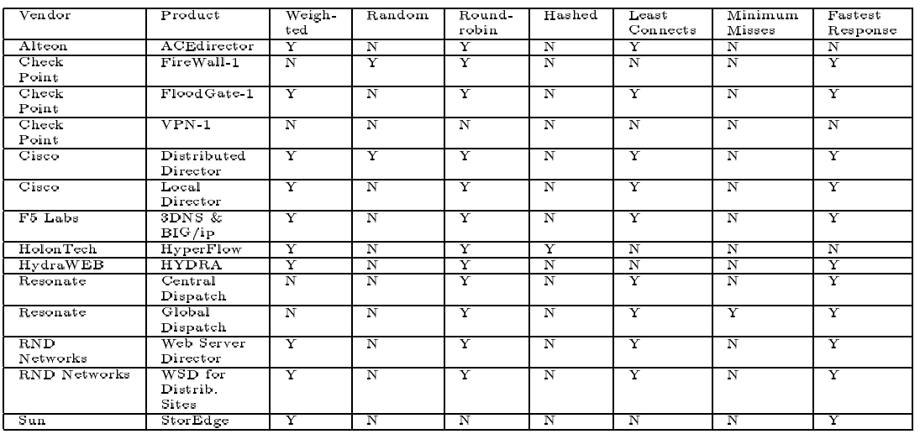
Simple Balancing Methods in Vendor Implementations

Slide 38
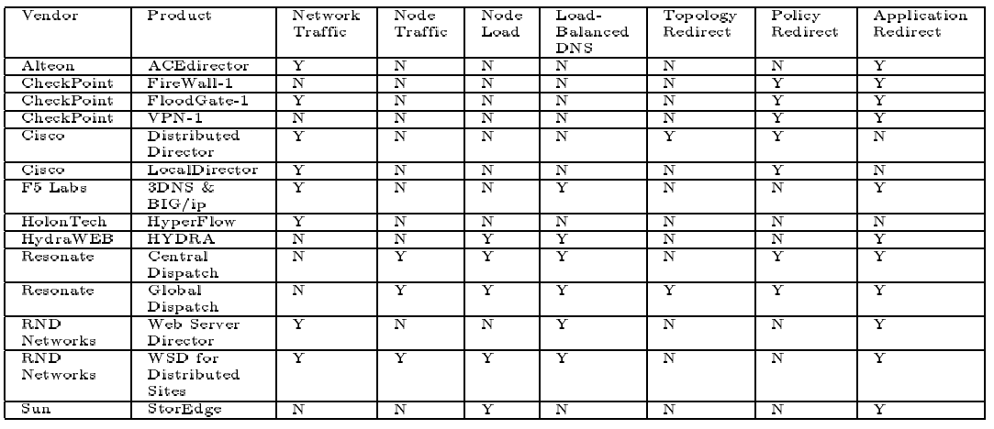
Advanced Balancing Methods in Vendor Implementations

Slide 39
General Network Traffic Implementations (I)
Independent of the software application using the network and transport layers
  IP balancing
  TCP session load-balancing only
  UDP session

Slide 40
General Network Traffic Implementations (II)
HolenTech HyperFlow
  Load balancing at the IP network level
    independent of the TCP and UDP
    not be functionally useful or efficient as balancing TCP sessions
  Weighting & round-robin in initial load balancing
  Two level hashing as the basic method for mapping
    one-to-one, many-source-to-one
    multiple balancing devices

Slide 41
General Network Traffic Implementations (III)
Cisco LocalDirector
  LAN-based system originally based on NAT
  CIP (Channel interface processor)
  80Mbps, 700,000 TCP connections, 8,000 IP map in 1997
  400Mbps, 1,000,000 TCP connections, 64,000 IP map now
Cisco DistributedDirector
  WAN-based system based on DNS
  Topology-based redirection
  UDP-based Director Response Protocol (DRP)

Slide 42
General Network Traffic Implementations (IV)
Resonate Central Dispatch
  Primary scheduler communicates with the agent to determine server and network traffic load
Resonate Global Dispatch
  Topology-based Redirection server that works with RCD
Alteon Networks ACEdirector
  10 or 100 Mbps Ethernet switches with load balancing
F5 Labs BIG/ip and 3DNS
  Load balancing, DNS, firewall

Slide 43
Web-specific Implementations
HydraWEB Load Manager
  Web content level clustering
  Portions of URL may be distributed across several nodes for asymmetric balancing
  Agents on nodes to monitor
RND Network Web Server Director and Director Pro
  LAN-based cluster WSN, WSN Pro
  WSN-DS (Distributed Sites) for distributed environment
  Dynamically reassigns nodes from other clusters to become part of the loaded system

Slide 44
Other Application Specific Implementations
Sun Microsystems StorEdge
  expansion of RAID to two-node cluster
  remote mirroring (replication)
  high-bandwidth direct connection between the two end-points
Check Point FireWall-1
  network access security monitors or firewalls
Check Point VPN-1
  IP-gateway providing certificate-based authentication
Check Point FloodGate-1
  bandwidth can be assignment via domain names, IP address, or user information

Slide 45
Summary
Separate balancing device
  in a network load balancing system
  monitor traffic
  execute a method of distributing traffic to a cluster of nodes
Balancing methods
  implemented independently, but very similar
DNS as a crucial part in many load-balancing method
Network layer (IP) & transport layer (TCP, UDP) implementation
Instead of QoS, best-guess and proprietary method

